Slide 1
An Objective Approach for Systematically Evaluating the Difficulty of Music Scores for Educators and Performers
Amy Gillick (agillick@vt.edu) Dept. of Music, Virginia Tech Eli Tilevich (tilevich@cs.vt.edu) Dept. of Computer Science, Virginia Tech

Slide 2
Ranking Complexity of Music Components
Complexity parameters
“What” (i.e., is being played)
Individual notes
Intervals
“How” (i.e., how “what” components are played)
Key signature
Dynamics
Tempo
Articulation: Slurred/Separated (i.e., legato/staccato)
Basic idea:
Rank each of the predefined complexity parameters
Use default values for unranked parameters
The “what” components get specific values
The “how” parameters become multipliers for “what” components

Slide 3
Example Complexity Ranking: Individual Notes
Target Domain: Introductory Clarinet
Notes assigned complexity rankings from
1 to 10
G3-G4 – 1
A4-2
B4-C5 – 5
C#5 and up - 10

Slide 4
Example Complexity Ranking: Intervals
Target Domain: Introductory Clarinet
Intervals assigned complexity rankings from
1 to 10
Unisons in any range – 1
Seconds in the G3-G4 range – 2
Thirds in the G3-G4 range – 3
Fourths in G3-G4 range – 4
Fifths in G3-G4 range – 5
Any intervals between the G3-G4 and B4-C5 ranges – 8
Any intervals between the B4-C5 and C#5 and up – 10
Any intervals (in any range) of a sixth-eighth – 9
Any intervals exceeding one octave - 10

Slide 5
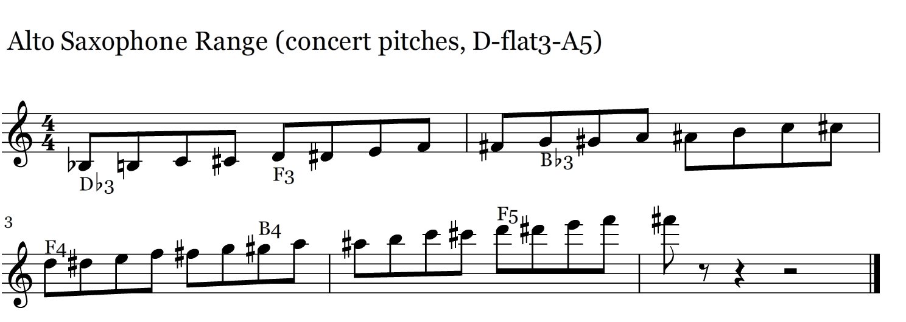
Example Complexity Rankings: Individual Notes
Target Domain: Introductory Saxophone
Notes assigned complexity rankings from 1-10
Bb3 to C#3 – 10
D3 to F#3 - 8
G3 to C#4 – 1
D4 to G4 – 6
G#4 to C#5 – 8
D5 to F#5 - 10

Slide 6
Example Complexity Ranking: Intervals
Target Domain: Introductory Saxophone
Intervals assigned complexity rankings from 1 to 10
Unisons in any range – 1
2nds-3rds in the B-flat 3 – Db3 range – 5
2nd-3rds in the D3-F# range – 3
2nds-4ths in the G3 to C#4 range – 1
2nds-4ths in D4-B-G4 range – 5
Any intervals between and ranges G#4-C#5 – 8
Any intervals D5 and above – 10
Any intervals (in any range) of a sixth-eighth – 9
Any intervals exceeding one octave - 10

Slide 7
Example Complexity Ranking: Dynamics
Target Domain: Introductory Clarinet/Sax
Dynamics assigned complexity scores from
1 to 10, which become multipliers for notes and intervals
mf & mp – 1
f – 1.1
ff – 1.2
p – 1.3
pp – 1.5

Slide 8
Example Complexity Ranking: Tempo
Target Domain: Introductory Clarinet/Sax
Tempo ranges assigned complexity scores
Metric: number of notes played per second
E.g., tempo 60; 1 group of 4 16th notes: 4 notes per second
1 to 10, which become multipliers for “what” metrics
1 note per second 1
2 notes per second 2
…
10 notes per second 10

Slide 9
Specific Examples
The next two slides present two versions of “Twinkle Twinkle Little Star,” labeled as level 1 and Level 2.
Each example is manually ranked to be played on saxophone, in accordance with the parameters discussed in previous slides.
Based on these parameters, the second example is more than twice as difficult as the first example.

Slide 10
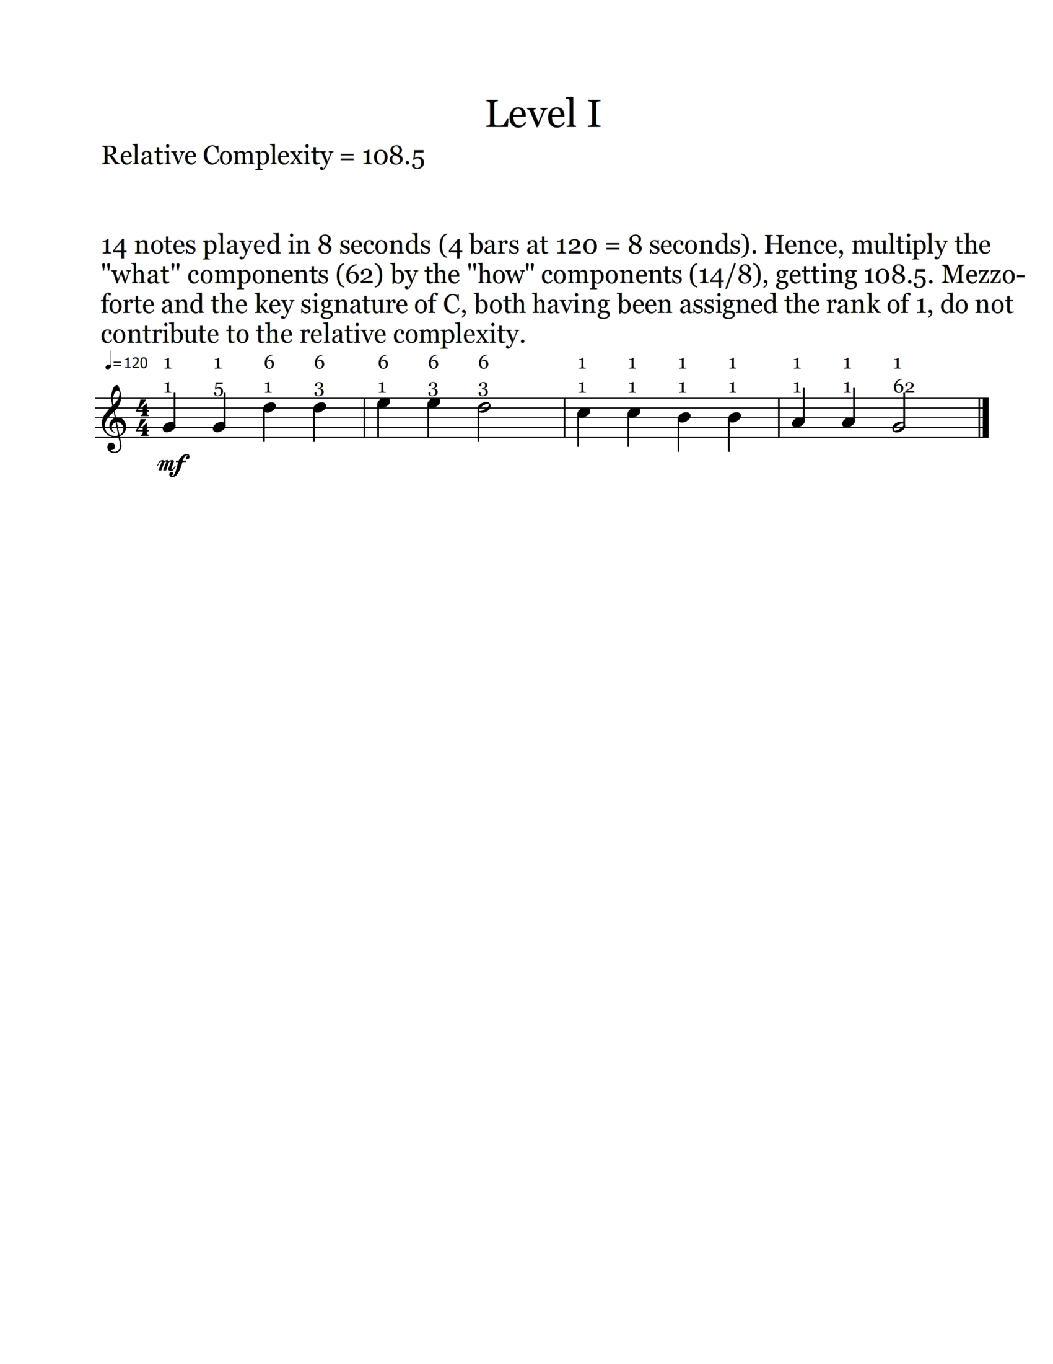

Slide 11
